Slide 1
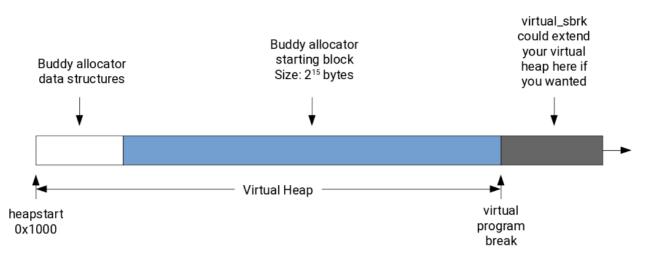

Slide 2
…………
Catalog
Size: 2^(initial_size – min_size)
(e.g. 2^(15-13) = 4)
uint8_t initial_size
(e.g. 15)
uint8_t min_size
(e.g. 13)
uint32_t Current_size
(initially 1)
(max node_num would be 2^32

Slide 3
Init_allocator(heapstart, init_size, min_size)
Catalog
Size: 2^(initial_size – min_size)
(e.g. 2^(15-13) = 4)
uint8_t initial_size
(e.g. 15)
uint8_t min_size
(e.g. 13)
uint32_t Current_size
(initially 1)
(max node_num would be 2^32
The first node equals to initial_size
1 byte each, encoded as int8_t
Which mean the upper bound would be 127
(eg 15)
To handle the difference between program_break and heapstart, it will firstly save the difference dif by computing (heapstart – virtual_sbrk(0)), then virtual_sbrk(dif).
The total size we need to sbrk would be 6 + 2^(init_size – min_size) + initsize

Slide 4
Virtual_malloc(heapstart, size)
Catalog
Size: 2^(initial_size – min_size)
(e.g. 2^(15-13) = 4)
uint8_t initial_size
(e.g. 15)
uint8_t min_size
(e.g. 13)
uint32_t Current_size
(initially 1)
(max node_num would be 2^32
The first node equals to initial_size
1 byte each, encoded as int8_t
Which mean the upper bound would be 127
(eg 15)

Slide 5
EXAMPLE
1. If there is node of the size we want, then make the found one to store (- size), nothing else changes.
(a node’s size is represented as its absolute value, while its sign (+/-) represents whether it is occupied.)
15
13
1
15
virtual_malloc(15)
15
13
1
-15
Return this address

Slide 6
EXAMPLE 2
If there is no node of the size we want, find the optimal node based on the required strategy.
Now apply malloc(13) to below example
16 | 13 | 3 | -14 | 14 | 15
Optimal node
1
As 14(optimal node) – 13(wanted node) = 1(will be referred as n), move all the following nodes by 1 block.
16 | 13 | 3 | -14 | 14 |  | 15

Slide 7
Process the change from optimal node to wanted node
In the example, it is
14 -> -13 and 13
16 | 13 | 3 | -14 | 14 |  | 15
Fill -13 and 13 in
16 | 13 | 3 | -14 | -13 | 13 | 15
Increase current_size block by n
16 | 13 | 4 | -14 | -13 | 13 | 15

Slide 8
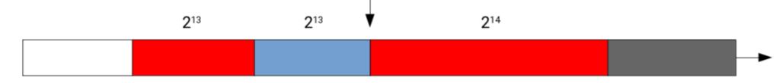
Virtual_free(heapstart, ptr)
EXAMPLE
If we want to free this ptr
15
13
3
-13
13
-14

Slide 9
15
13
3
13
-13
-14
(heapstart + 6 + 2^(15-13))
(heapstart + 6 + 2^(15-13) + 2^13)
(heapstart + 6 + 2^(15-13) + 2^13 + 2^13)
= ptr

Slide 10
15
13
3
-13
13
-14
15
13
3
-13
13
14
Due to the time limitation, free’s demo ends here, feel free to ask though.

Slide 11
Virtual_realloc(heapstart, ptr, size)
Not much to talk about, especially when ptr = null or size = 0.
Apart from that, we have 2 possible circumstance:
Successfully realloc
Failed reallocation and nothing changes

Slide 12
The way to handle both possibility
1. Create a list called stash to store current catalog.
2. Free the ptr
3. Malloc the required size
Malloc failed
Malloc succeed
Use stash to restore original catalog
Copy & past all the content within original block to the newly allocated block
Then return the new ptr.

Slide 13
A trick to resolve a problem when free. --how to determine who is the buddy (left/right) of the freed block if they are both the same size
-13 | 13 | -13 | 13 | -13 | 13 | -13 | 13
Say free this block

Slide 14
-13 | 13 | -13 | 13 | -13 | 13 | -13 | 13
Count the number of continuous block with same value on its left
Here it is 4
The number is even
The number is odd
Its buddy is the right-first
Its buddy is the left-first

